Slide 1

Olympic Games
Brandon Huang, Hannah Koschmeder, Stephanie Cao

Slide 2
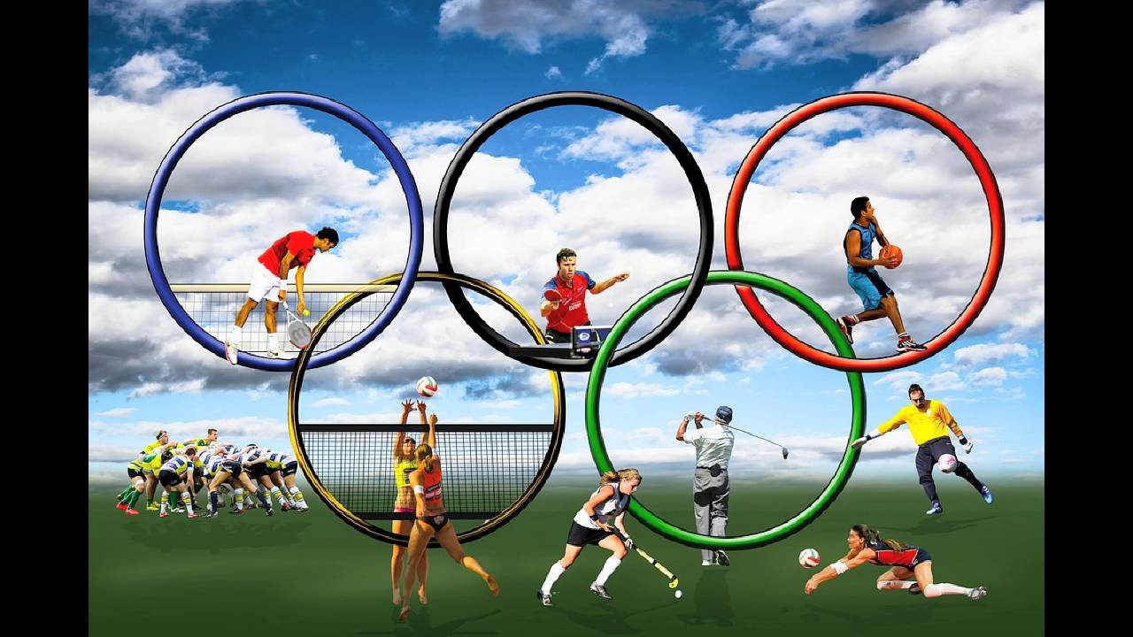
Motivation
Factors into team winning a medal (General and Sports specific)
People love watching the Olympics - every 2 years (Summer & Winter)
Finding out predictability of team winning in the Olympics
Notes:
People love watching the Olympics

Slide 3
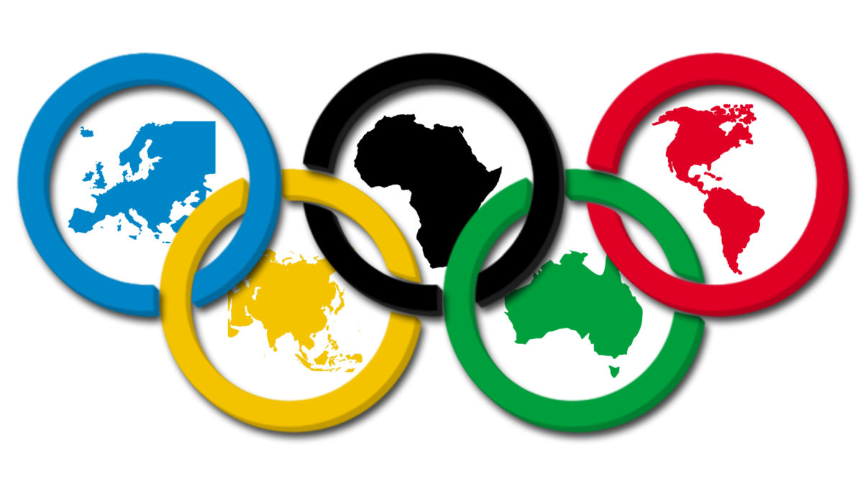
Agenda
Exploratory Data Analysis
Medal Focus: Predicting future medals on past performance and other factors
Medal Focus: Effect of GDP
Predictive Power of Country on attaining medals
Sport Focus: Gymnastics, Swimming, Beach Volleyball

Slide 4
Exploratory Data Analysis

Slide 5
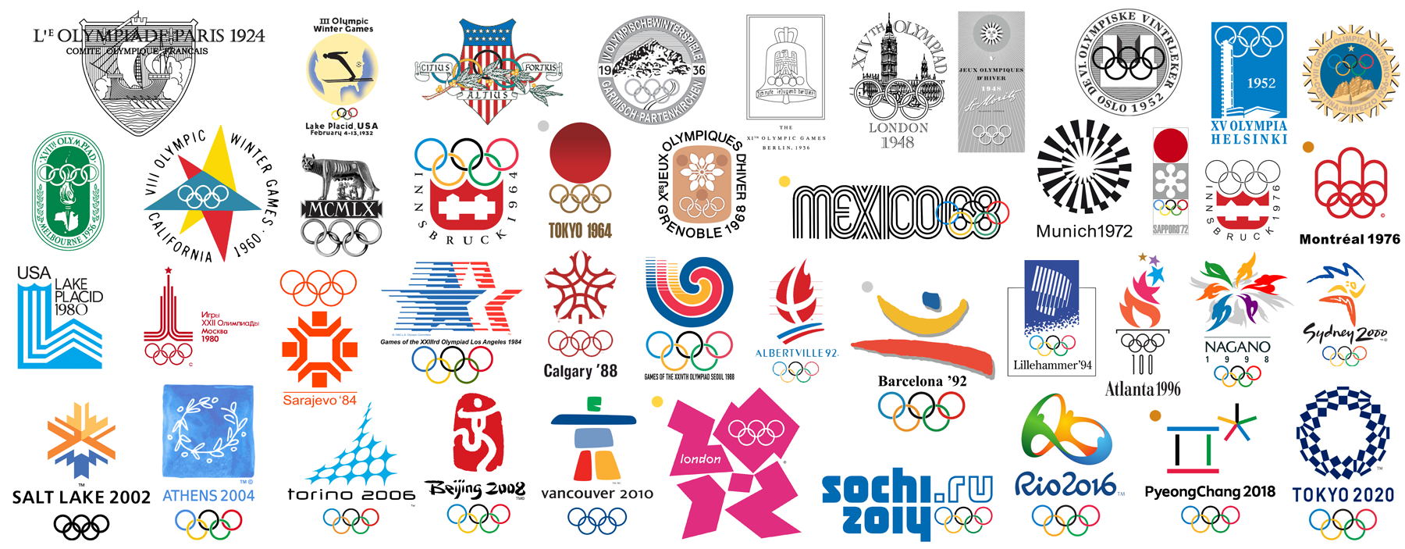
120 Years of Olympic History in this Data!
Olympic Results from Athens 1896 to Rio 2016
Each row corresponds to an athlete and the event that he/she competed in
Columns include Name, Sex, Age, Height, Weight, Season, Sport, Country, and Medal.

Slide 6
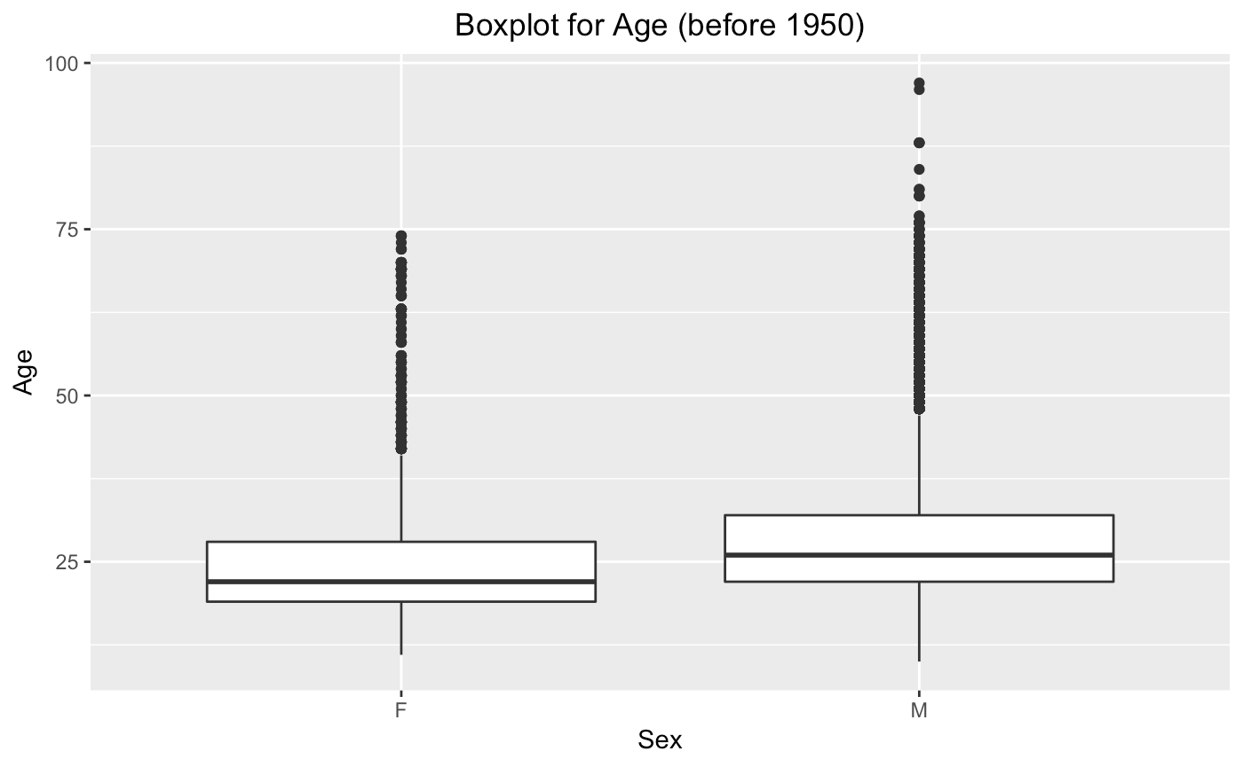
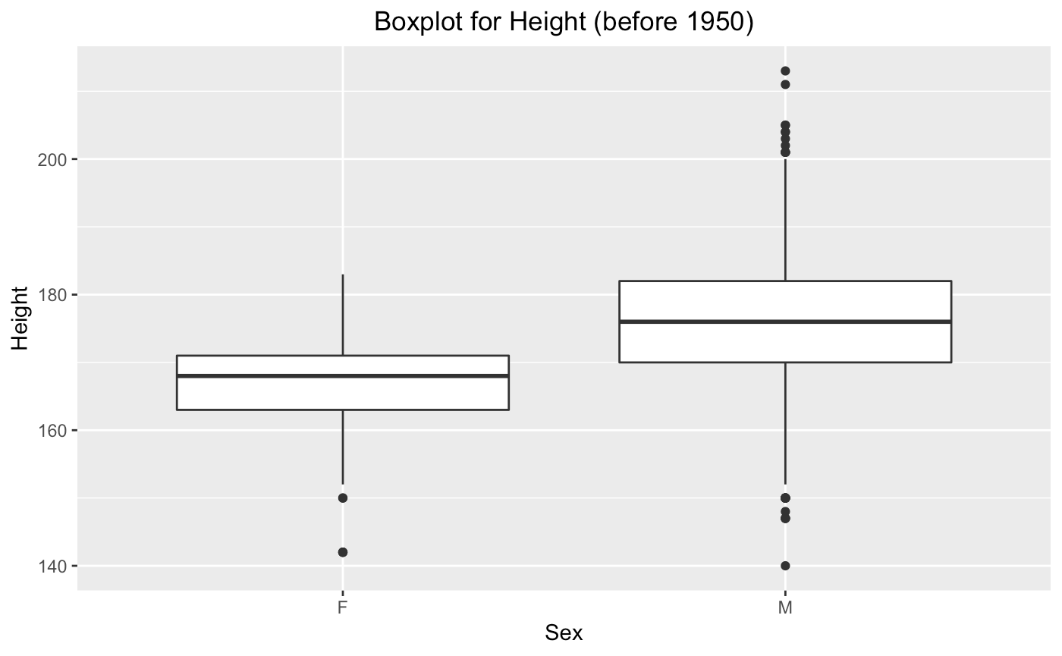
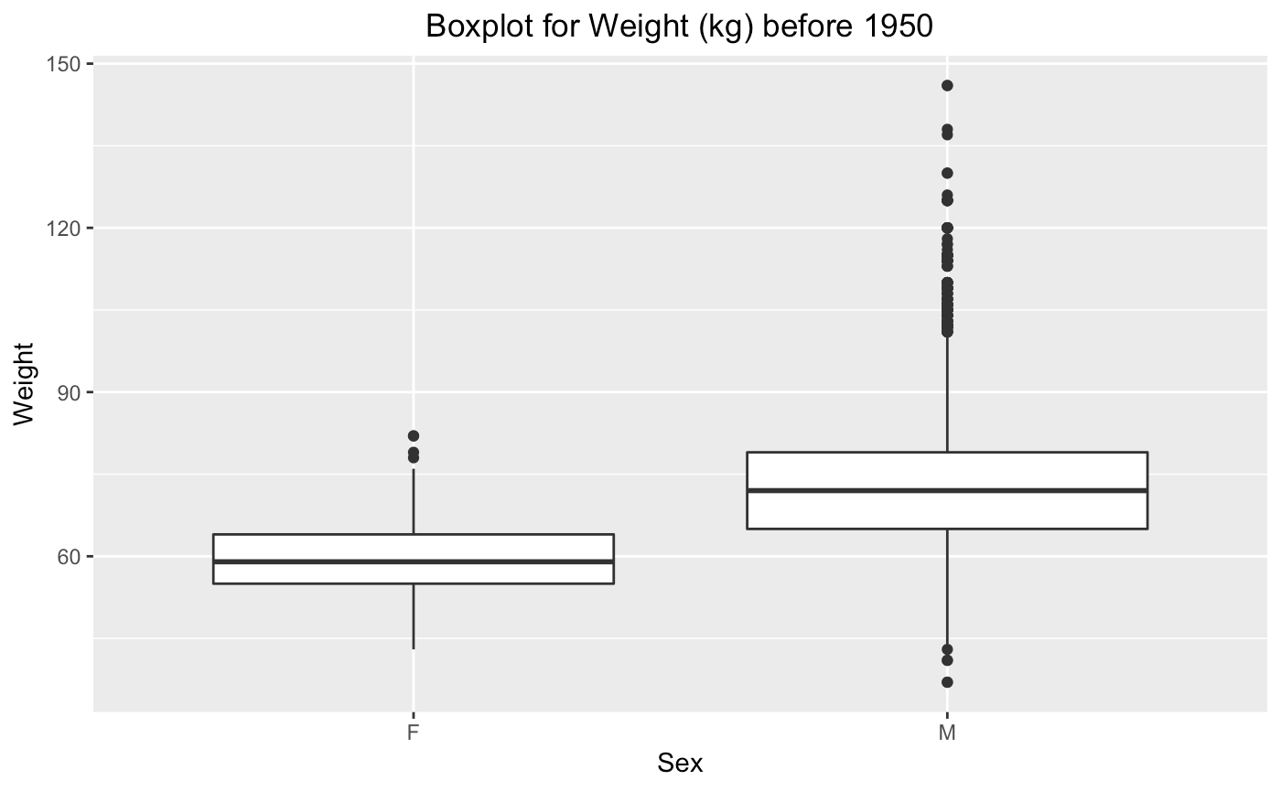
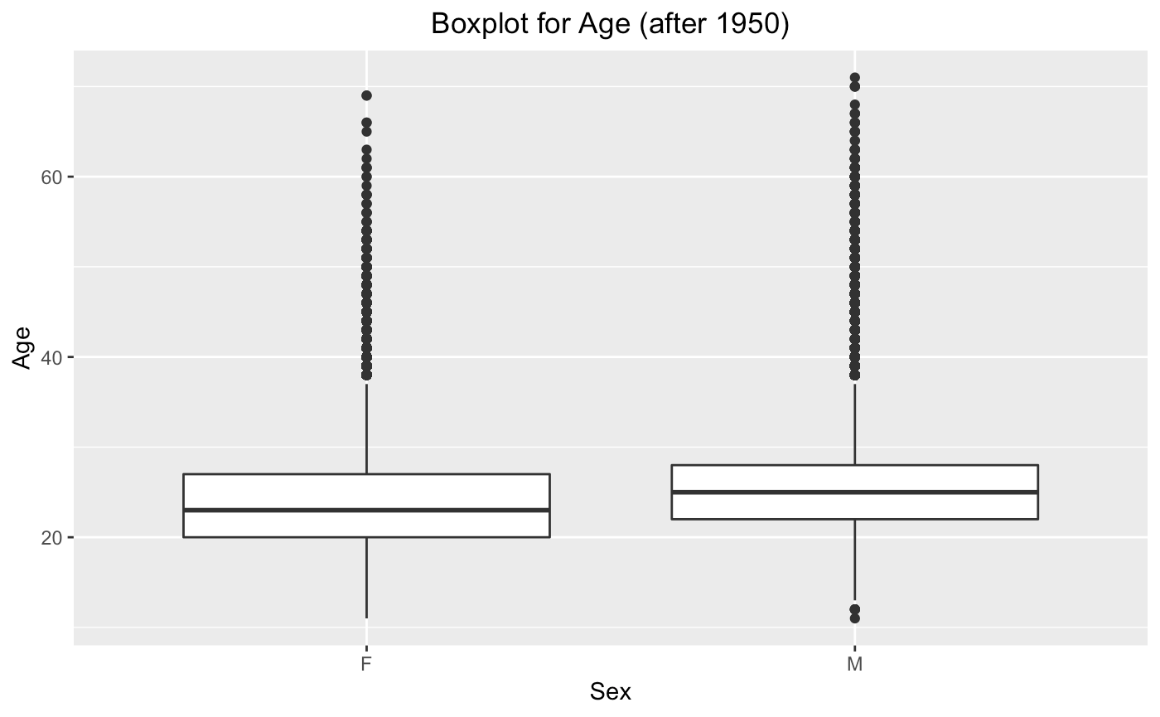
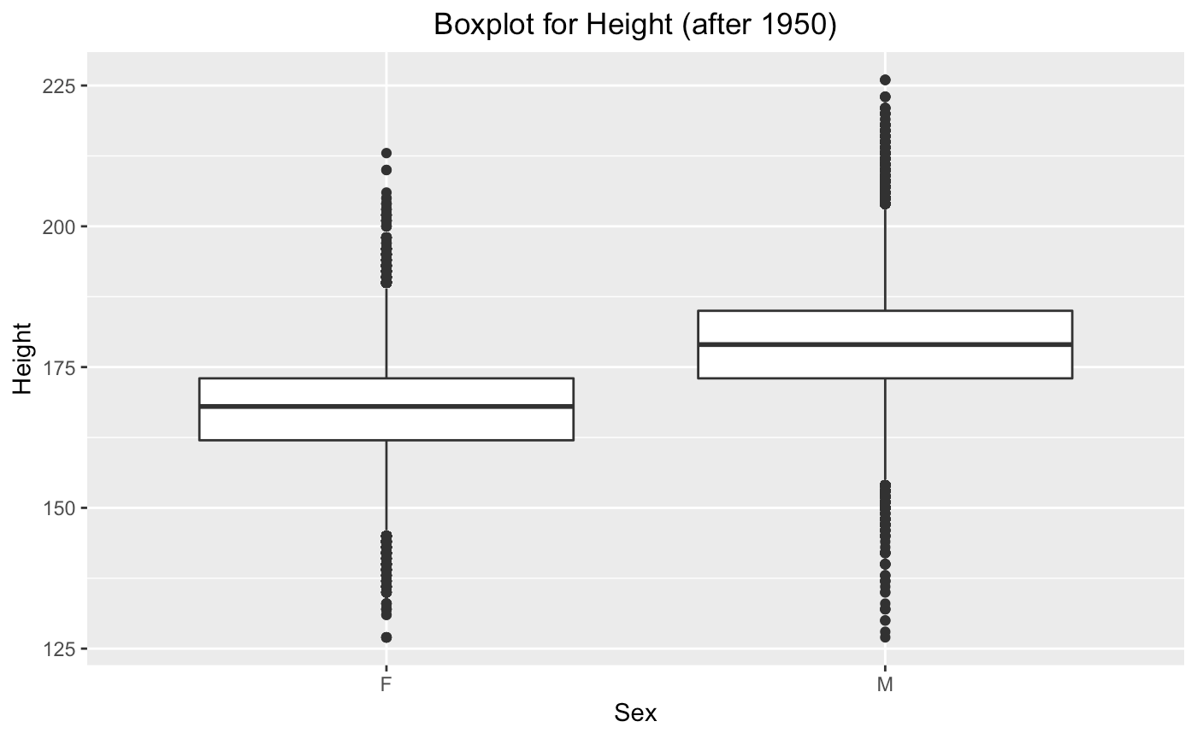
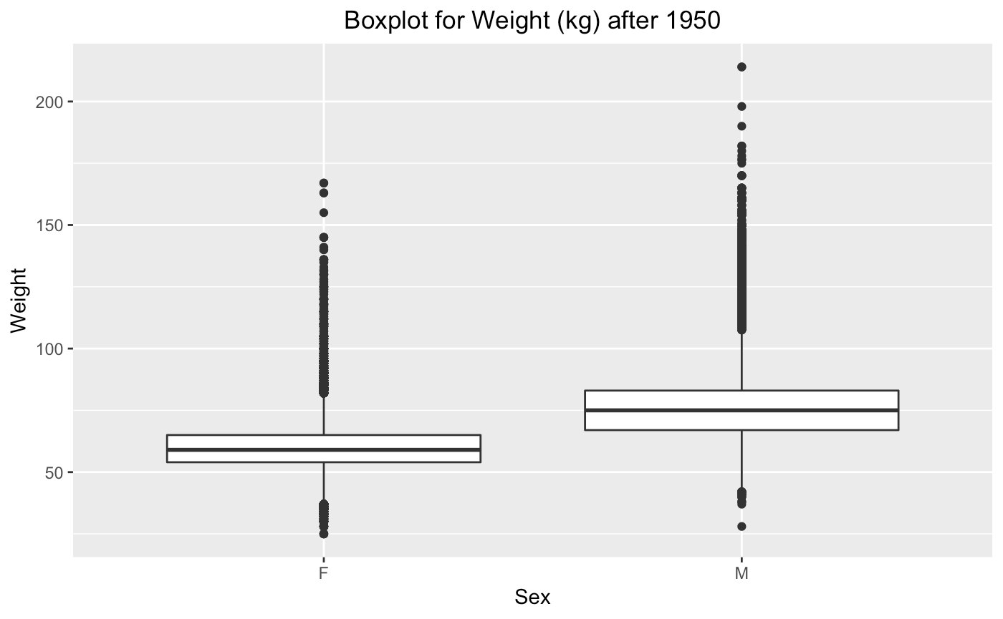
Exploratory Data Analysis
Notes:
Range of values

Slide 7
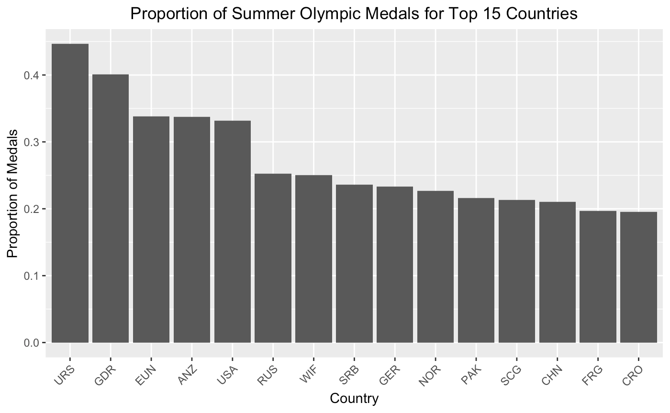
Exploratory Data Analysis

Slide 8
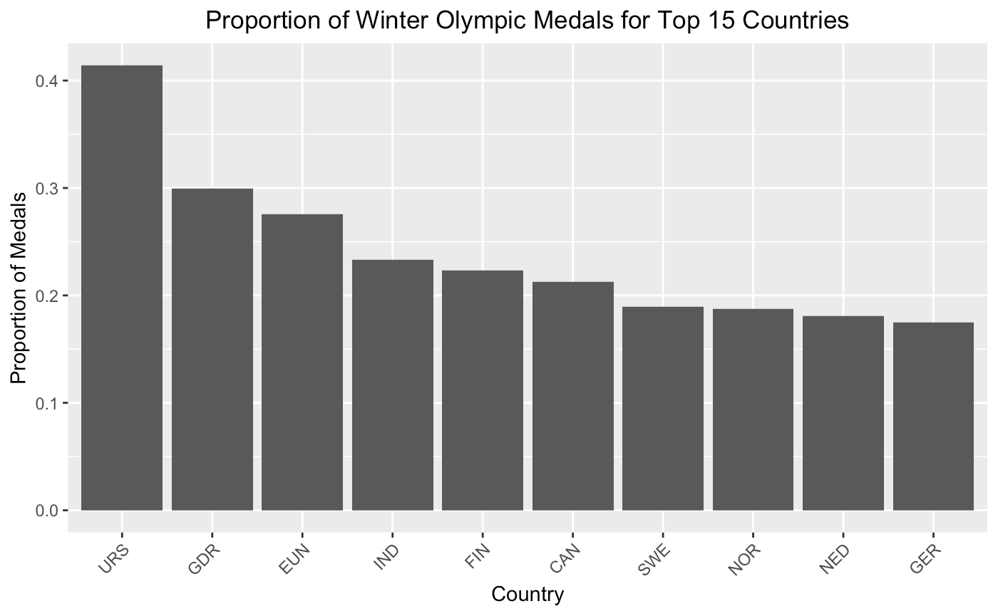
Exploratory Data Analysis

Slide 9
Total Medal Prediction
Notes:
Broad overview of the factors for a country to medal and the issues with those factors

Slide 10
Potential Explanatory Variables and Issues
Population
population composition (old vs. young, male vs. female)
population density
GDP per Capita - relative wealth of individuals in country
Government Funding - do athletes fund themselves? Is their sport expensive?
little cohesive data
Corruption
little cohesive data
Availability of Facilities
little cohesive data

Slide 11
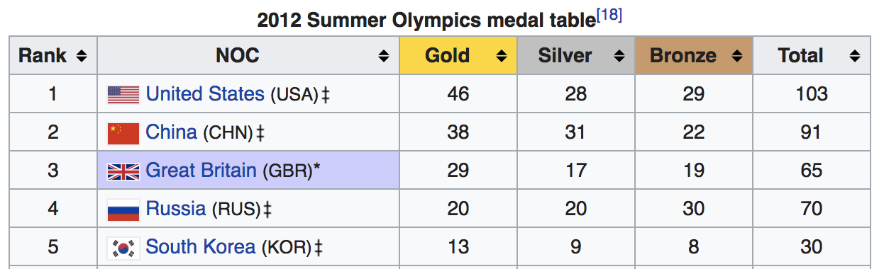
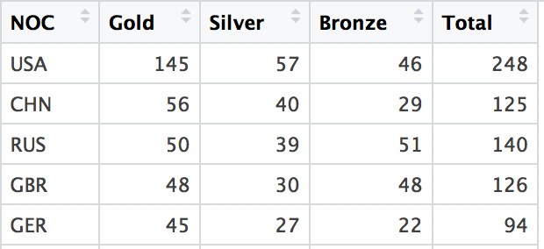
Notable About Medal Counts
2012 Summer Olympics Total Medals
Official counts award one medal per event, our counts don’t distinguish this. This inflates the Total Medal Count.
Some countries have never won medals.
By creating a dataset for the totals, we reduced our dataset to 1,900 rows.
Notes:
Due to team sports that aren’t played in tandem (team gymnastics, etc)
https://en.wikipedia.org/wiki/2012_Summer_Olympics_medal_table

Slide 12
Testing & Comparing Country vs Population
Full Model
Total Medals = B₀ + B₁log(Population)+ B₂:B₁₁₆Country_{2:116}
Only Population
Total Medals = B₀ + B₁log(Population)
Only Country
Total Medals = B₀ + B₁:B₁₁₅Country_{1:115}
Are Country and Population both necessary?
Yes, Country has major predictive power, and Population keeps some information not kept by Country.

Slide 13
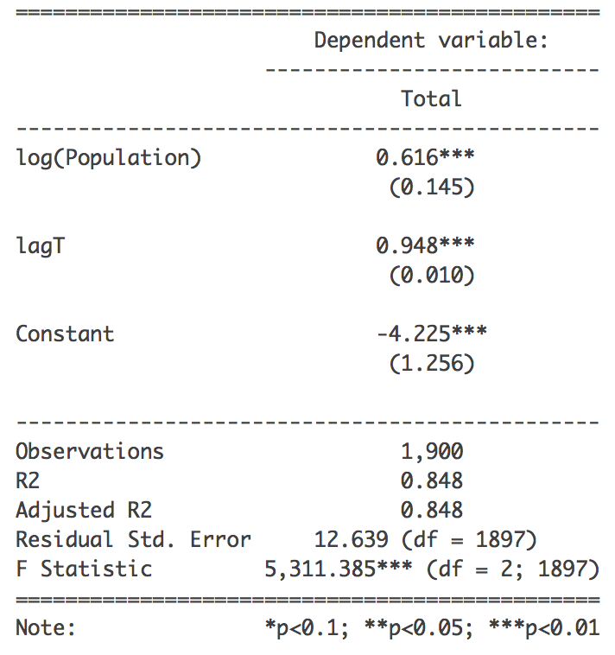
Adding in Previous Number of Medals Won
The previous Olympics’ medals can help predict the next years, this is lag
Is not insignificant, shown by partial F-test
Helps the model keep more information, shown by AIC

Slide 14
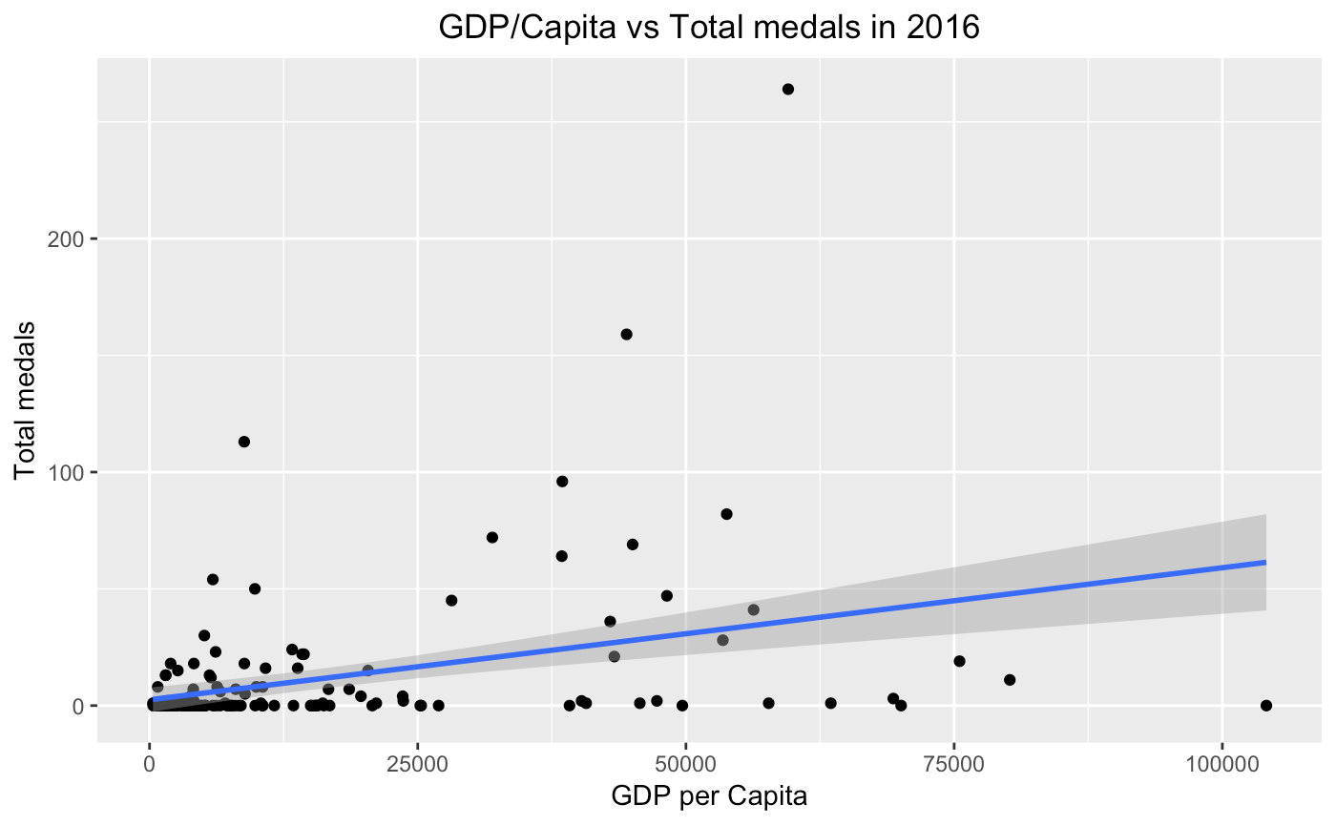
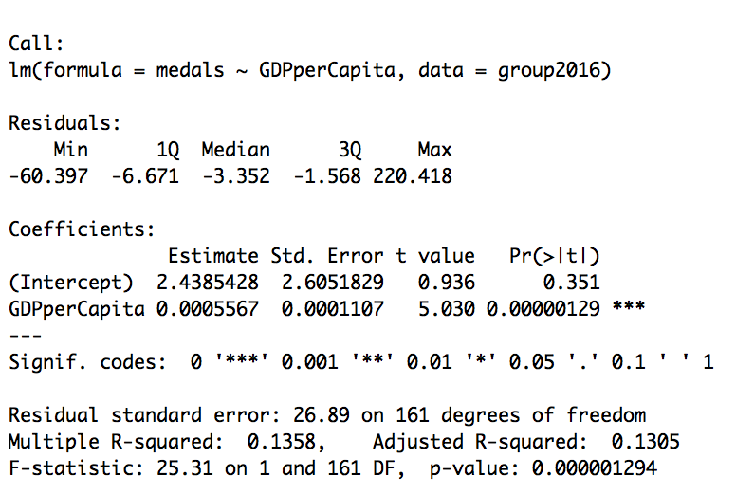
Effect of GDP per Capita on attaining medals
Notes:
Statistically significant predictor, high r^2 for a single predictor, positive correlation

Slide 15
Effect of GDP per Capita on attaining medals
Logistic Regression for attaining medal (0.50 threshold)
Accuracy = 0.8557
Kappa = 0.0
AUC = 0.60
GDP per Capita has little predictability of attaining medal.
Notes:
Testing the validity of country as a predictor in a different way
Comparing the predictability of country on winning a medal

Slide 16
Predictability of Country on Medal: Basketball
Basketball
Logistic Regression for Men’s basketball (0.5 threshold)
Accuracy = 0.9027
Kappa = 0.6616
AUC = 0.9414
Logistic Regression for Women’s basketball (0.5 threshold)
Accuracy = 0.8686
Kappa = 0.6842
AUC = 0.9381
Very high predictability of attaining medal based on country

Slide 17
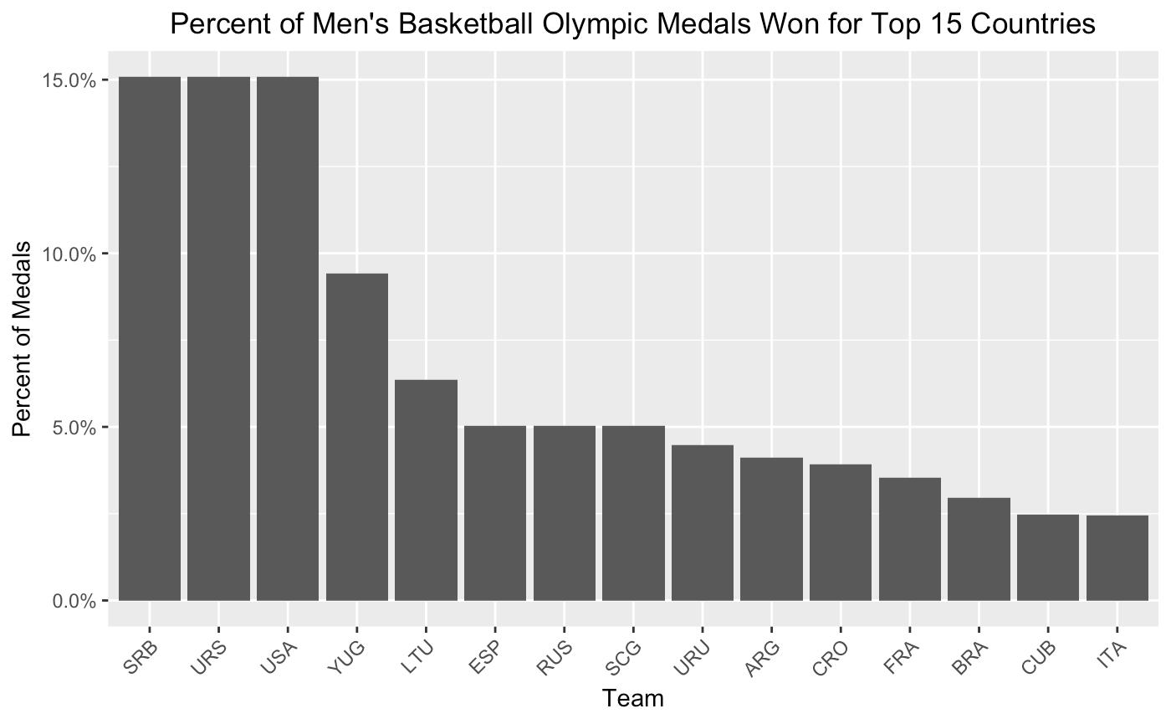
Predictability of Country on Medal: Basketball

Slide 18
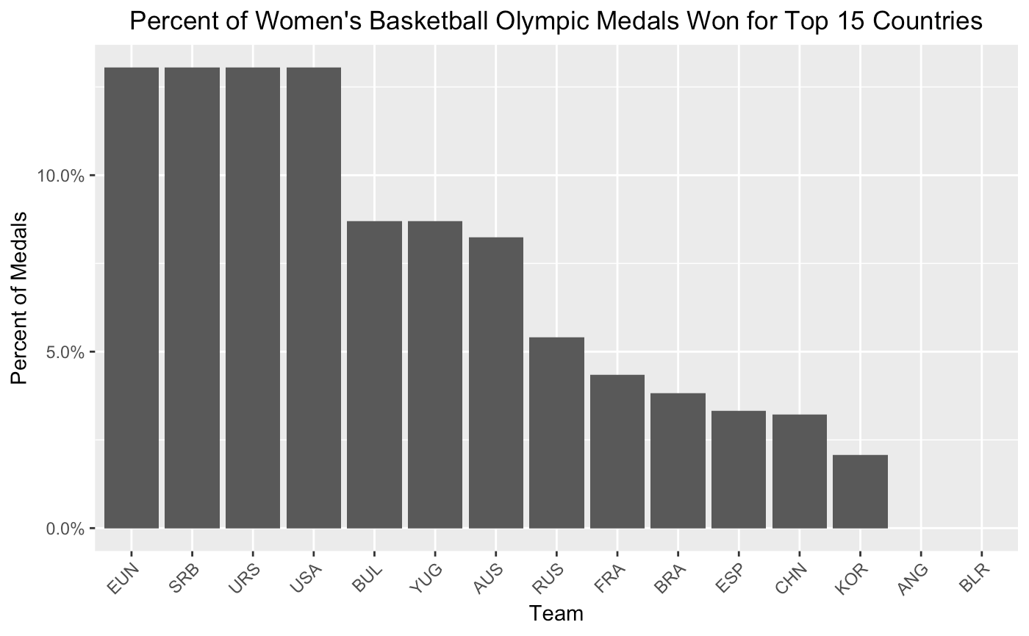
Predictability of Country on Medal: Basketball

Slide 19
Predictability of Country on Medal: Sailing
Sailing
Logistic Regression for Men’s Sailing (0.5 threshold)
Accuracy = 0.9025
Kappa = 0.6328
AUC = 0.9262
Logistic Regression for Women’s Sailing (0.5 threshold)
Accuracy = 0.8683
Kappa = 0.1847
AUC = 0.8027
For sailing, also has high predictability of attaining medal for men, but not so much for women.

Slide 20
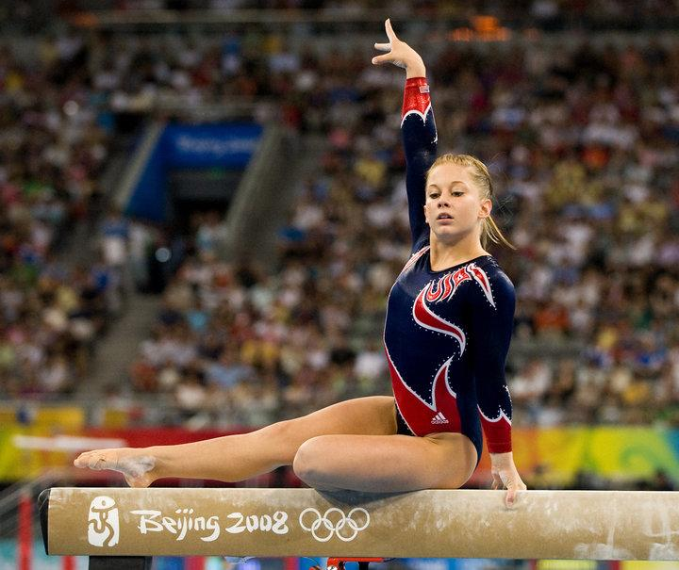
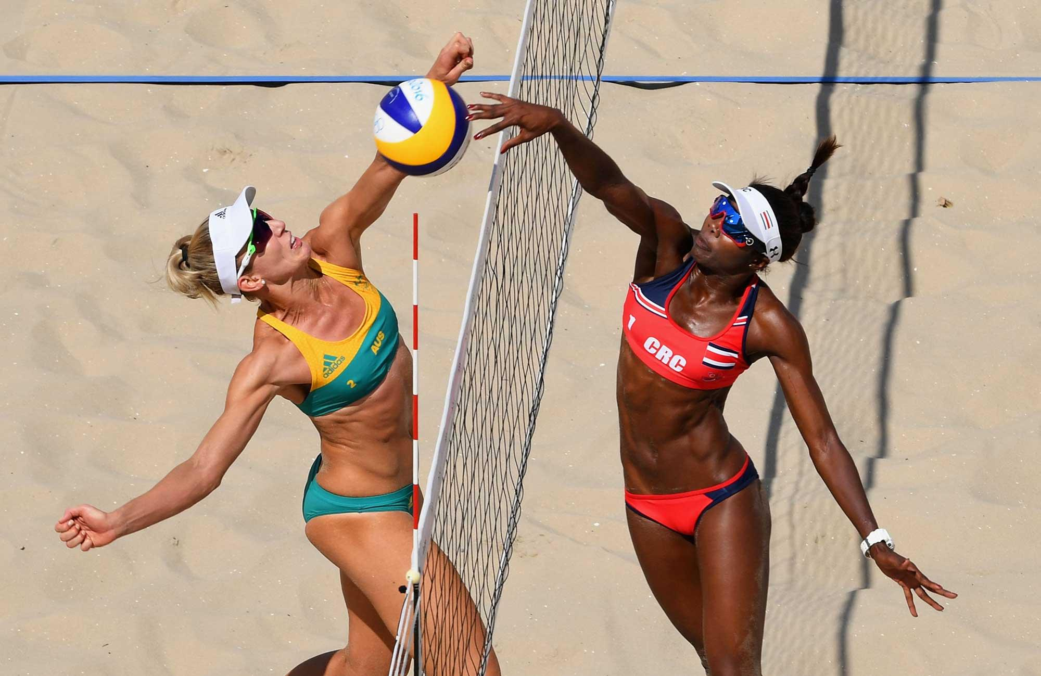
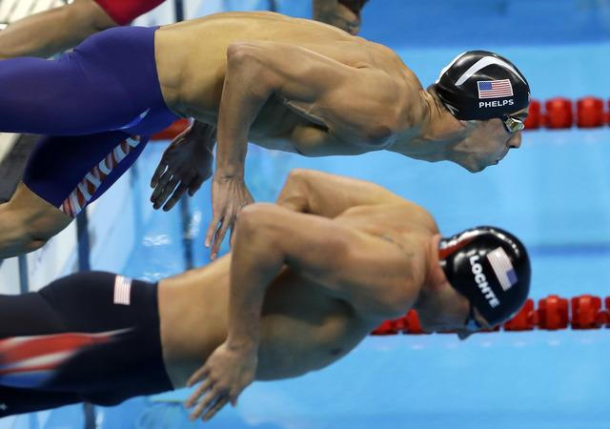
Gymnastics, Swimming, and Volleyball
Notes:
Deep dive!

Slide 21



Analysis on 3 Popular Olympic Sports
Analysis
Variables: age, height, weight, country
How they changed overtime
Effect of winning a medal
Predicting athletes
Effect of Olympic Experience
Sports
Gymnastics
Swimming
Beach Volleyball
Notes:
Next, we did an analysis on 3 popular olympic sports that are watched on TV, which are gymnastics, swimming, and beach volleyball.
For each of these sports, we analyzed certain variables such as the athletes’ age, height, weight, and country and studied how they changed overtime and the effect on winning a medal.
In addition, we used logistic regressions to predict certain athletes and their chances of winning.
Finally, we studied whether athletes do better when they’ve had more Olympic experience.

Slide 22
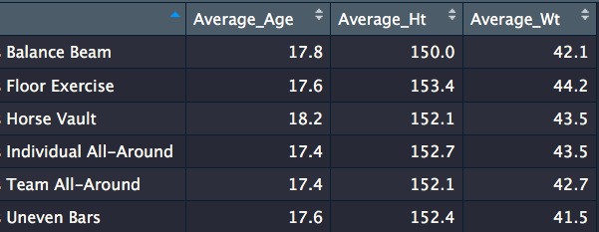

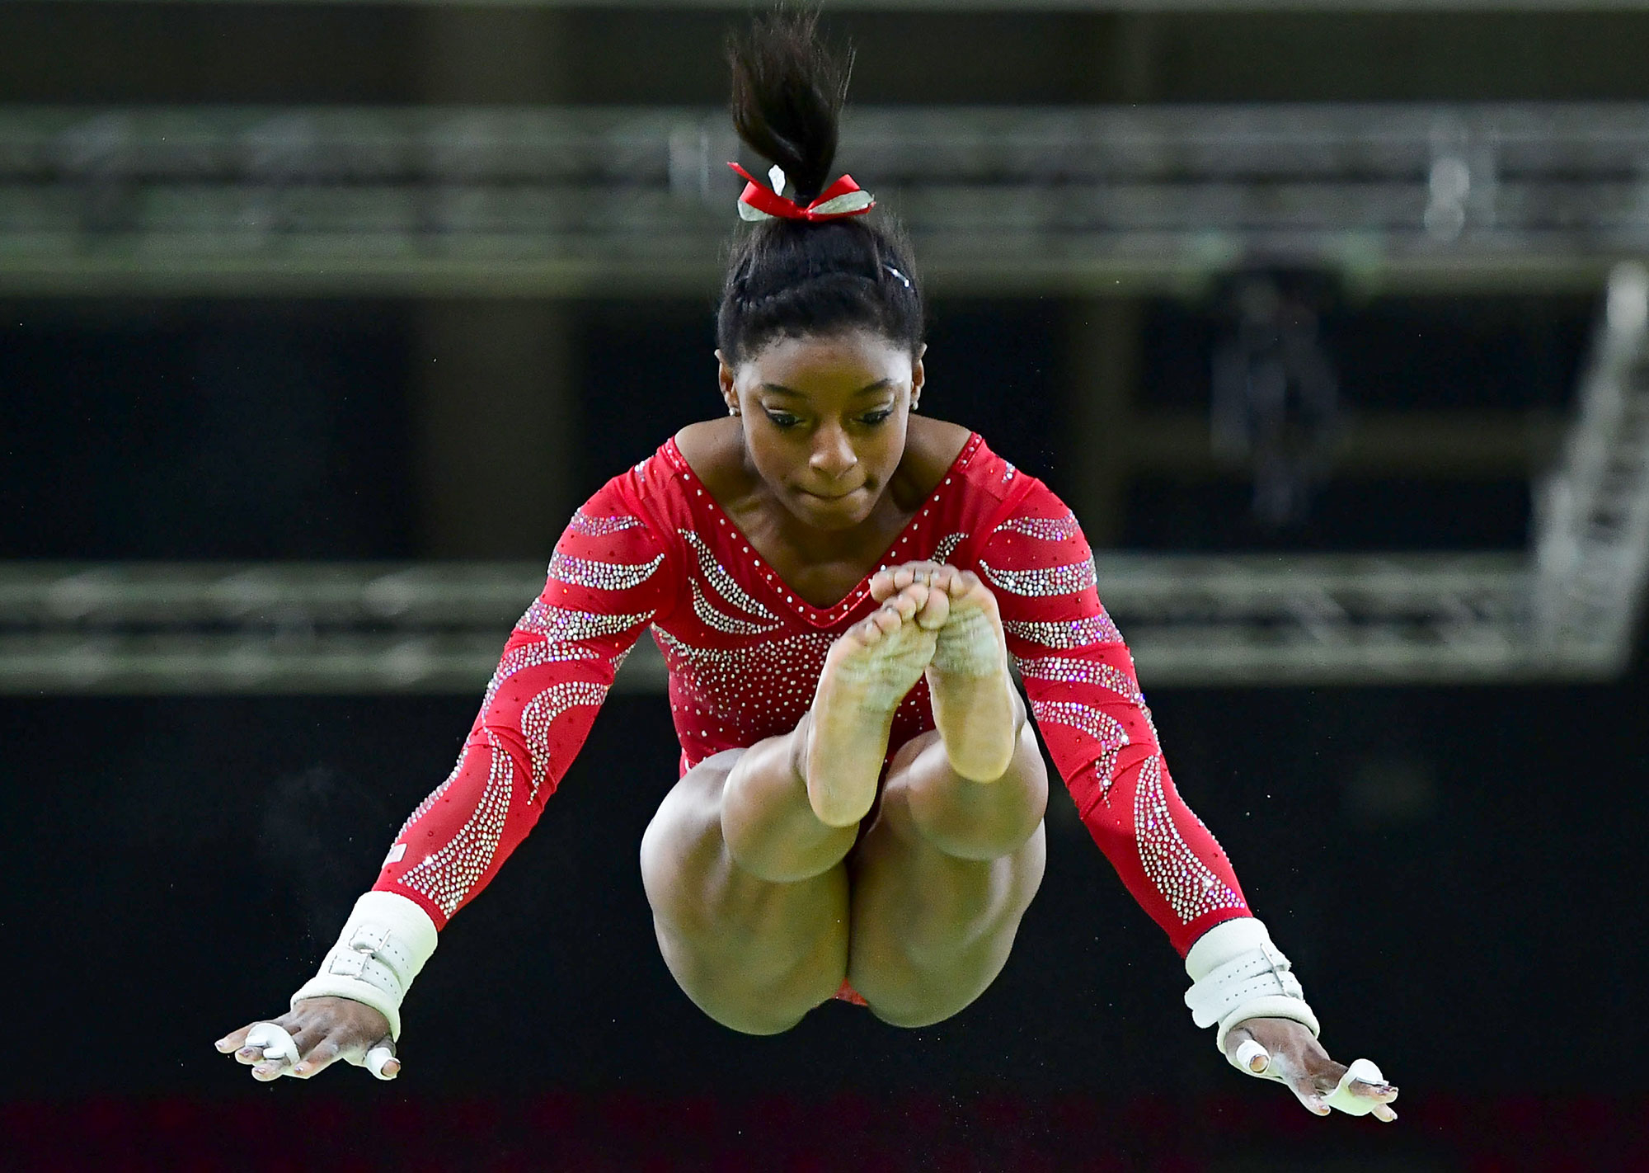
Women’s Gymnastics
Ideal Qualities for Each Event:
How does Simone Biles Compare?
Age: 17-18
Height: 150-153 cm
Weight: 41-44 kg
Notes:
So now, let’s study the ideal qualities of women gymnastics. What we did here was we looked at the average age, height, and weight of the gymnasts after 1980s who’ve medalled. We chose after 1980s because there was a distinct difference amongst gymnasts after 1980s and prior to.
Now, how does Simone Biles, one of the most decorated gymnasts in history compare? She clearly doesn’t fall into the average, yet she is currently the best gymnast in the world.

Slide 23
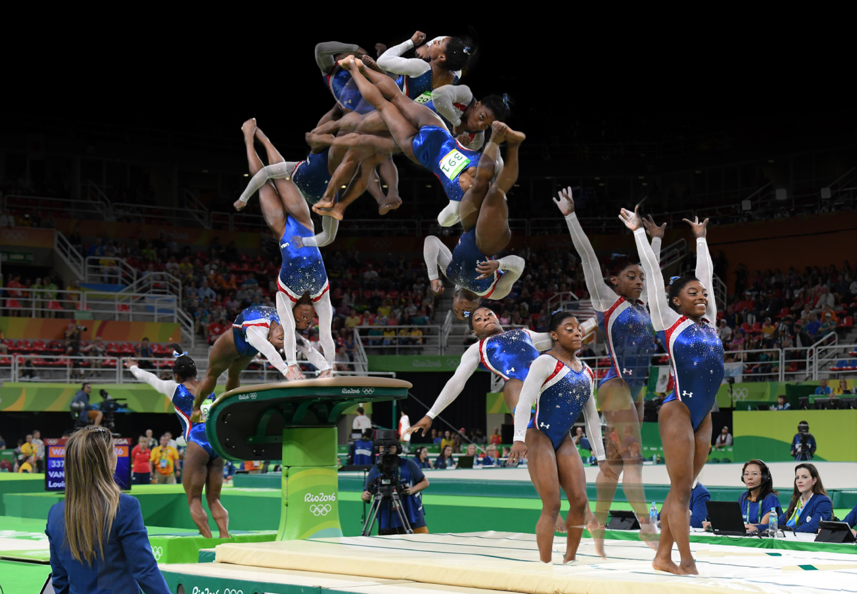
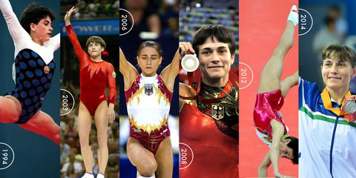
Now let’s talk about Oksana Chusovitina
What are her chances of winning a medal in 2020 on the vault?
A logistic regression: Height = 153, Weight = 44, Age = 45, Team = "Uzbekistan"
Probability: 4.853308e-09
Compared to Simone Biles: 0.317
Notes:
Now let’s talk about Oksana Chusovitina. Chusovitina is 43 years old right now and she is still competing. In fact, she came out of retirement for the 2008 Olympics to compete in order to raise money for her son who had leukemia, and she won silver on the vault that Olympics.
Her chances of medalling in the vault in 2020 is very slim at 4.85*10^-9 due to her age, yet she’s made the vault finals in the 2016 games.

Slide 24
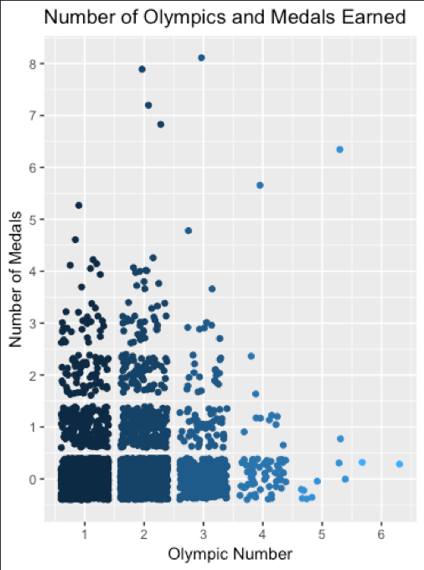
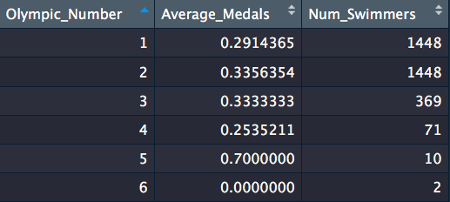
Men’s Swimming
Effect of Olympic Experience
Average Number of Medals does increase with more Olympic Experience
For a small group of athletes - Michael Phelps, Ryan Lochte, etc.
Notes:
Next, we studied swimming, and what we did here was on men’s swimming. We wanted to see how Olympic experience effects winning. If you look at the red box, we see that the average number of medals has increased for those in their second Olympics than first.
Now if you look at the blue box, it looks like the 5th Olympics is when Olympians win the most; however, if you look at the graph, most win 0-1 medal, except that one person with 6, who is Michael Phelps.

Slide 25
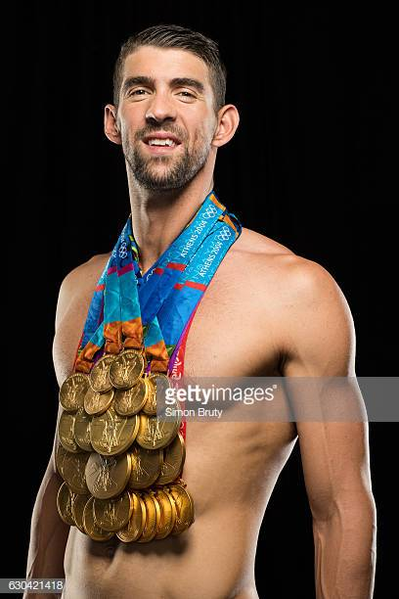
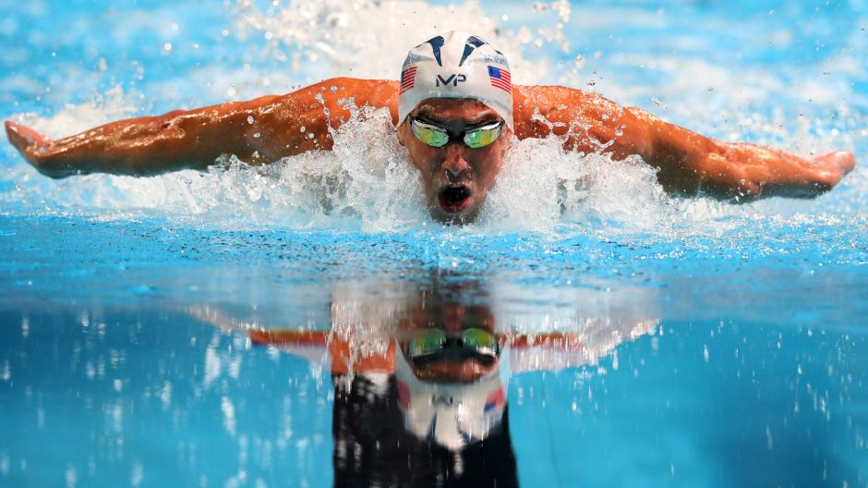
Michael Phelps’ chances of winning the 100m butterfly in 2016
Height = 193 Weight = 88 Age = 31 (for 2016)
NOC = USA Event = Swimming Men's 100 metres Butterfly
Using a logistic regression: 0.70
Notes:
Michael Phelps is the most decorated Olympian in history, who just retired. Let’s look at his chances of winning the 100m butterfly in 2016. Using a logistic regression, we predicted that he had a 70% chance of medalling.
#Michael Phelp's chances of medalling in 2016
phelps100mB_2016 <- data.frame(Height = 193, Weight = 88, Age = 31, NOC = "USA", Event = "Swimming Men's 100 metres Butterfly")
predict(swimmingM.logit,phelps100mB_2016, type = "response") #0.70

Slide 26
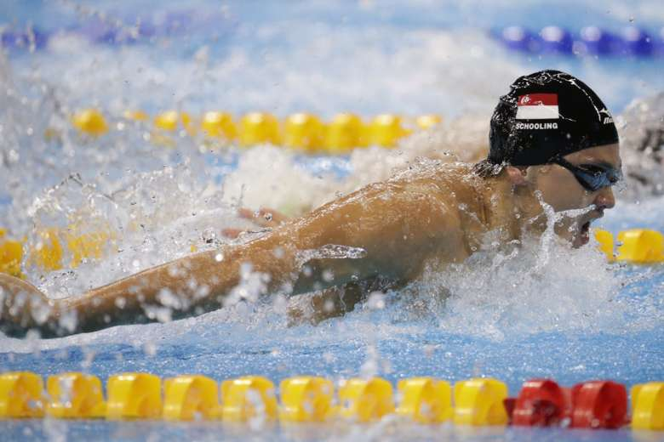
...and Joseph Schooling’s Chances of winning that event
Height = 184 Weight = 74 Age = 21 (for 2016) and 25 (for 2020)
NOC = SGP Event = Swimming Men's 100 metres Butterfly
Using a logistic regression:
For 2016: 0.01
For 2020: 0.01
Notes:
Now let’s study Joseph Schooling’s chances.
In 2016, he was a 21 year old from Singapore, we predicted that he had a 1% chance, and if he were to compete again, he still has only a 1% chance.
#Joseph Schooling's chances of winning again in 2020 (100m butterfly - the event that he beat Micahel Phelps)
schooling100mB_2020 <- data.frame(Height = 184, Weight = 74, Age = 25, NOC = "SGP", Event = "Swimming Men's 100 metres Butterfly")
predict(swimmingM.logit,schooling100mB_2020, type = "response") #0.011
#Joseph Schooling's probability of winning a medal in 2016
schooling100mB_2016 <- data.frame(Height = 184, Weight = 74, Age = 21, NOC = "SGP", Event = "Swimming Men's 100 metres Butterfly")
predict(swimmingM.logit,schooling100mB_2016, type="response") #0.01

Slide 27
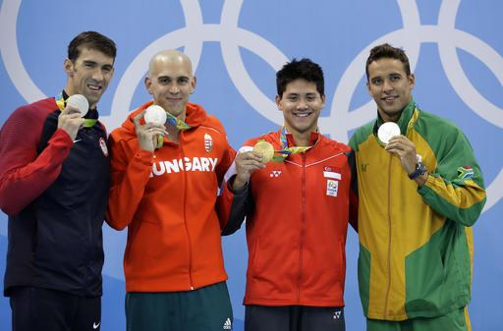
Joseph Schooling actually beat Michael Phelps in that race in 2016...
Model predicted that Schooling had a 1% chance in 2016
Supposed Schooling was from the US, his chances increased to 57%
He does train in the US and was on the UT Austin swim team
Phelps had a 70%
Conclusion: Country plays a huge factor
Notes:
Now, what if I told you that in 2016, Joseph Schooling actually beat Michael Phelps in that race in 2016!
Suppose Schooling was American, we predicted that his chances increased to 57%.
In conclusion, country is a very strong predictor in our model.
#Joseph Schooling is trained in the US. What if he was American?
schooling100mB_2016US <- data.frame(Height = 184, Weight = 74, Age = 21, NOC = "USA", Event = "Swimming Men's 100 metres Butterfly")
predict(swimmingM.logit,schooling100mB_2016US, type="response") #0.57
schooling100mB_2020US <- data.frame(Height = 184, Weight = 74, Age = 25, NOC = "USA", Event = "Swimming Men's 100 metres Butterfly")
predict(swimmingM.logit,schooling100mB_2020US, type = "response") #0.59

Slide 28
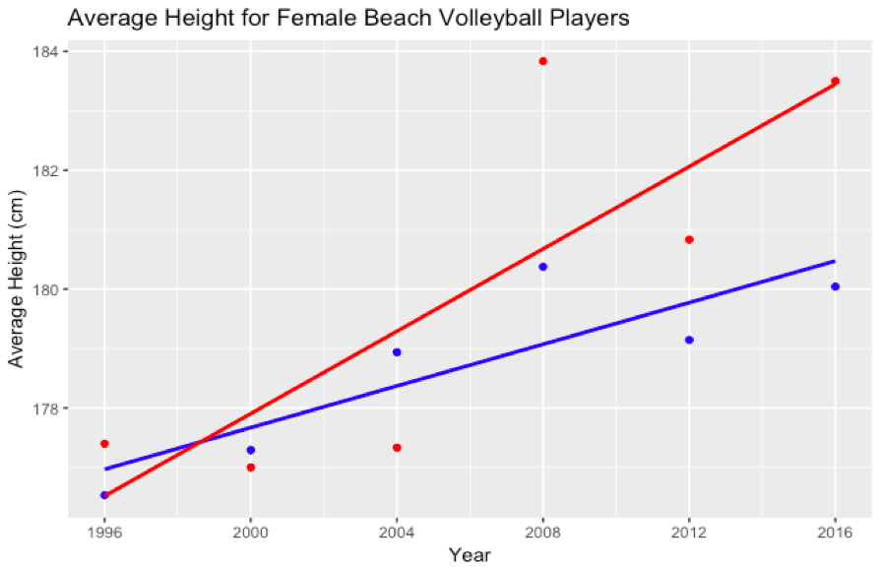
Beach Volleyball
Overall
Medalled
Notes:
Our third sport was beach volleyball. Here, this graph compares the average heights over the years of female beach volleyball players overall in the blue and those that medalled in the red. We see that average height has increased for both over the past few years.

Slide 29
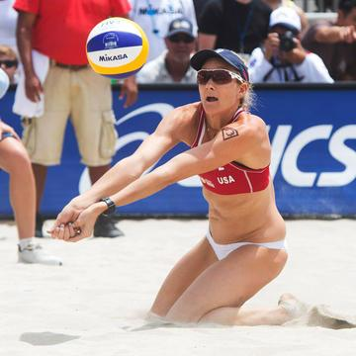
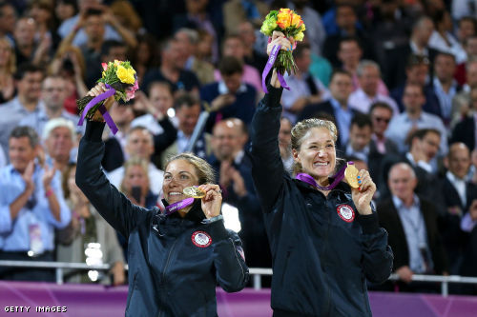
Predict Kerri Walsh’s chances of winning in 2020
Height = 191 Age = 42 Weight = 71 NOC = USA
Using a logistic regression: 0.67
Notes:
Now, let’s talk about one of the best beach volleyball players in history, Kerri Walsh. She has 3 Olympic Gold medals and 1 Bronze. Our logistic regression predicted that she has a 67% chance of medaling again in 2020.

Slide 30
Conclusion
Country has the greatest influence in predicting success of athletes
But shallow! It doesn’t address what made this country successful
Average wealth of a country does not correlate with greater successes in winning medals
Some countries are historically better at some sports than others
Easier to predict the winners of some sports with reasonably high accuracy
Future Analysis
More data analysis from different sources
Historical research about raw success factors

Slide 31
Questions?

Slide 32
Appendix: Data Sources
Olympic Data: https://www.kaggle.com/heesoo37/120-years-of-olympic-history-athletes-and-results
UN Population Data: https://population.un.org/wpp/Download/Standard/Population/
UN Country Codes: https://unstats.un.org/unsd/tradekb/Knowledgebase/50377/Comtrade-Country-Code-and-Name
World Bank:
https://data.worldbank.org/indicator/NY.GDP.PCAP.CD?view=map

Slide 33
Appendix

Slide 34
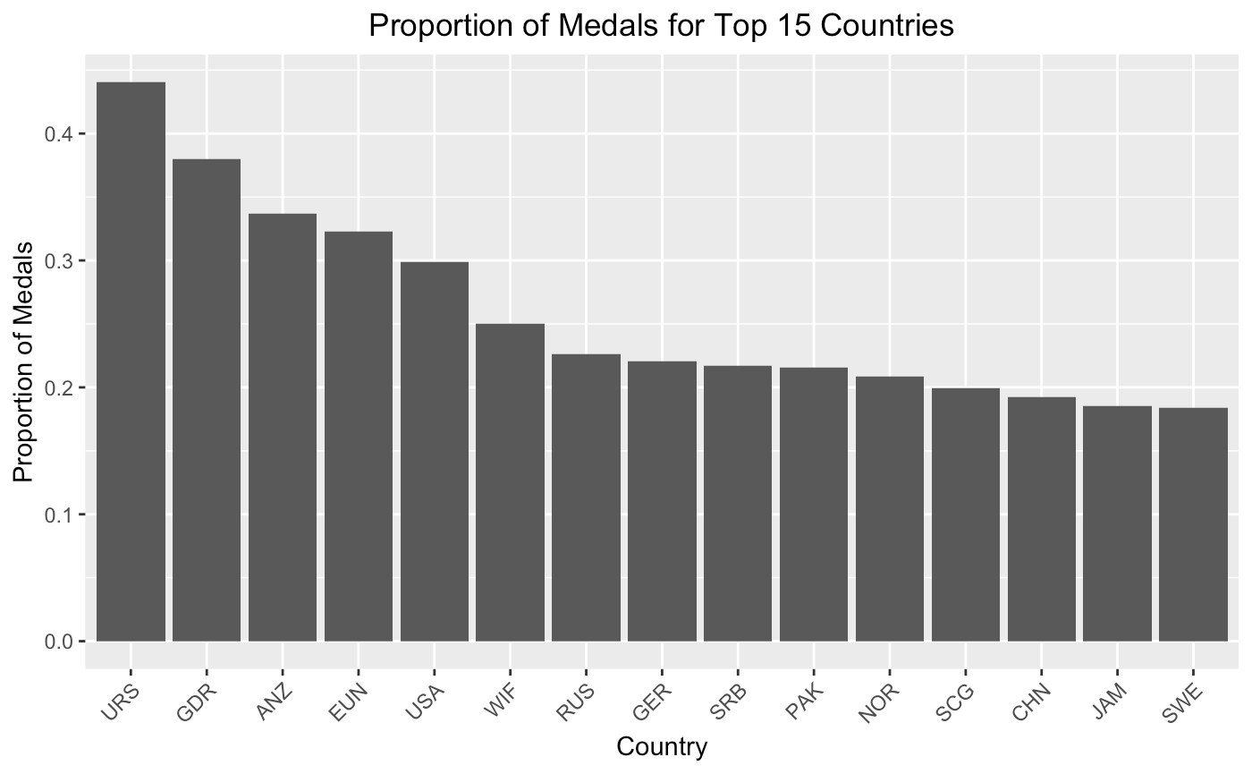

Slide 35
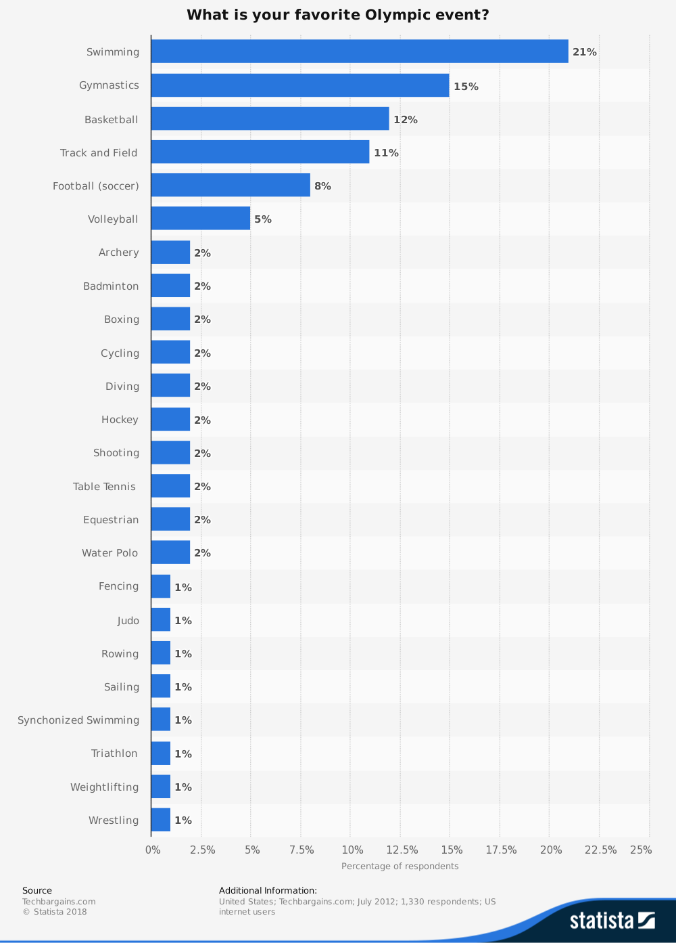
Popular Sports

Slide 36
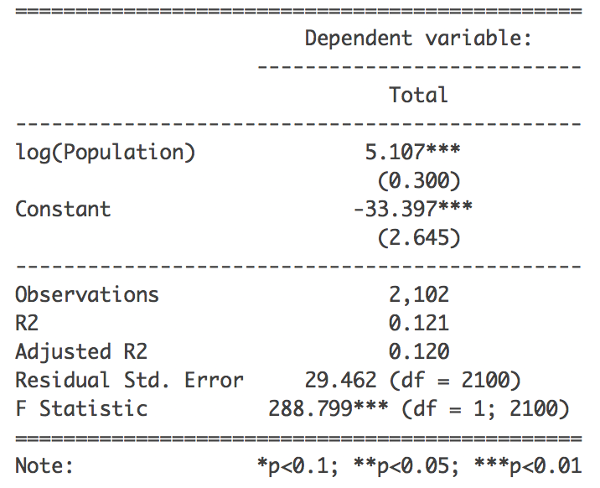
Regression Outputs for Population

Slide 37
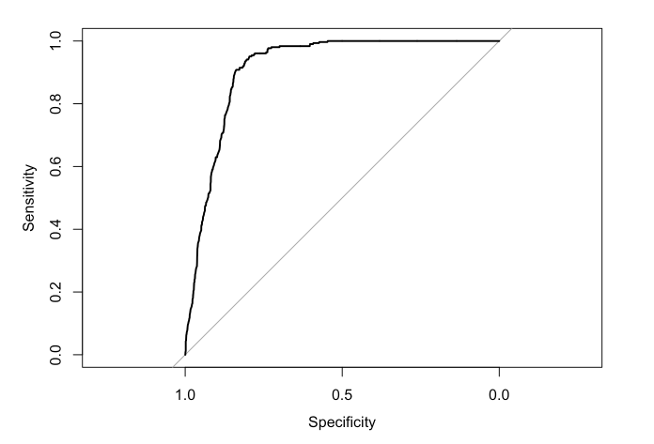
ROC Curve for Logistic Regression on W. Gymnastics
AUC: 0.91

Slide 38
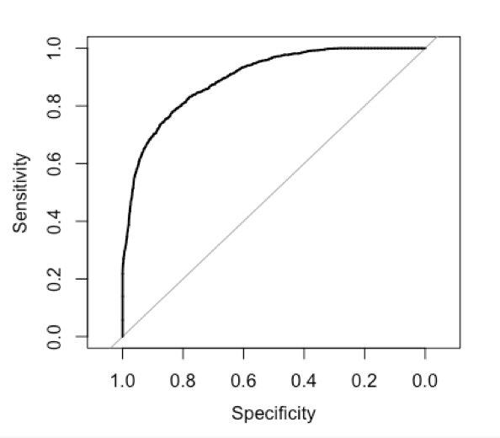
ROC Curve for Logistic Regression on M. Swimming
AUC: 0.90

Slide 39
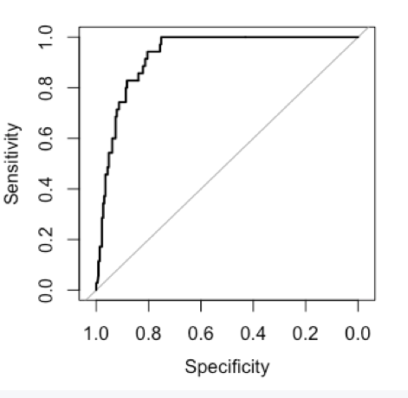
ROC Curve for Logistic Regression on W. Beach Volleyball
AUC: 0.93

